Slide 1
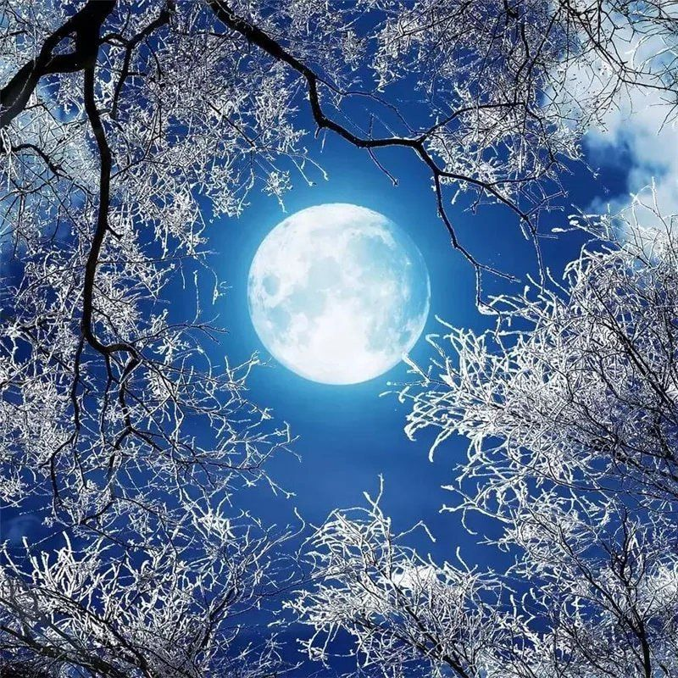
Pedagogika fakulteti
III bosqich 44-18 guruh talabasi
Xidirova Maftuna

Slide 2
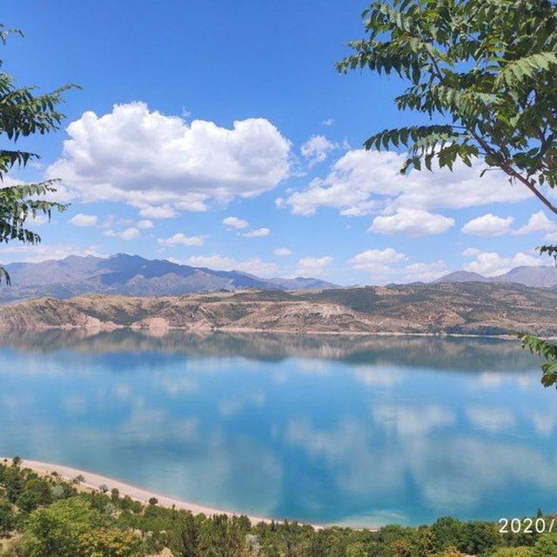
3-sinf Ona tili darsligida sõz yasovchi qõshimchalar mavzusi tahlili
Sõz yasovchi qõshimchalar 164-166-mashq
Sõz yasovchi qõshimchalar 167-169-mashq
Sõz yasovchi qõshimchalar 170-172-mashq
Sõz yasovchi qõshimchalar 173-176-mashq
Sõz yasovchi qõshimchalar 177-179-mashq
Ot yasovchi qõshimchalar 246-248-mashq
Ot yasovchi qõshimchalar 249-251-mashq
Ot yasovchi qõshimchalar 252-254-mashq
Ot yasovchi qõshimchalar 255-256-mashq
Sifat yasovchi qõshimchalar 269-271-mashq
Sifat yasovchi qõshimchalar 272-274-mashq
Sifat yasovchi qõshimchalar 275-277-mashq
Sifat yasovchi qõshimchalar 278-280-mashq
Sifat yasovchi qõshimchalar 281-283-mashq
Sifat yasovchi qõshimchalar 284-285-mashq
Fe'l yasovchi qõshimchalar 340-342-mashq
Fe'l yasovchi qõshimchalar 343-345-mashq
Fe'l yasovchi qõshimchalar 346-348-mashq
Fe'l yasovchi qõshimchalar 349-351-mashq

Slide 3
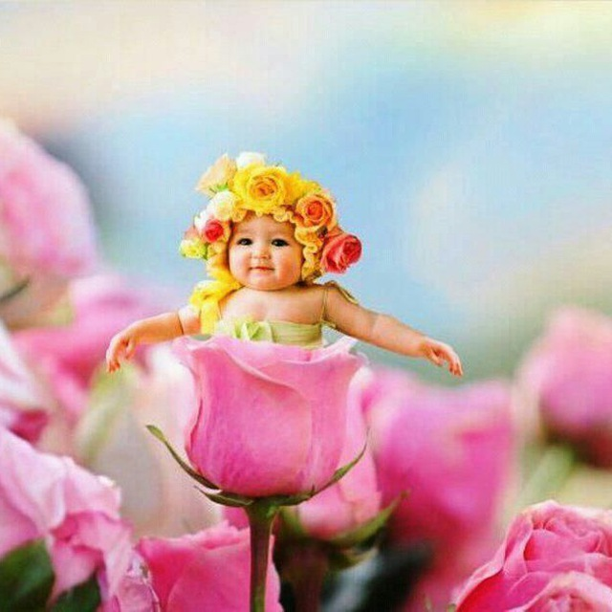
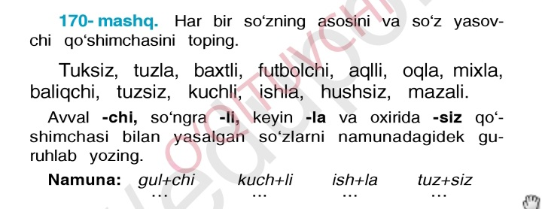
Tuk+siz tuz+la baxt+li futbol+chi
aql+li oq+la mix+la baliq+chi
tuz+siz kuch+li ish+la hush+siz
maza+li

Slide 4

3-sinf Ona tili darsligida Sõzlarni õzaro boğlovchi qõshimchalar mavzusi tahlili
Sõzlarni õzaro boğlovchi qõshimchalar 180-183-mashq
Sõzlarni õzaro boğlovchi qõshimchalar 184-186-mashq
Sõzlarni õzaro boğlovchi qõshimchalar 187-189-mashq
Sõzlarni õzaro boğlovchi qõshimchalar 190-192-mashq
Sõzlarni õzaro boğlovchi qõshimchalar 193-195-mashq
Sõzlarni õzaro boğlovchi qõshimchalar 196-198-mashq
Sõzlarni õzaro boğlovchi qõshimchalar 199-200-mashq

Slide 5
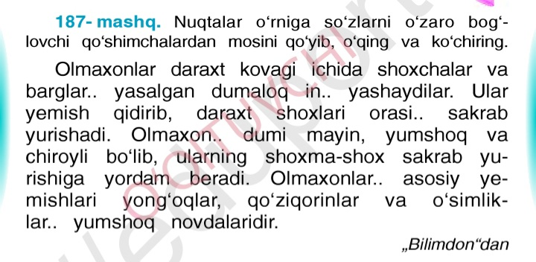

Slide 6
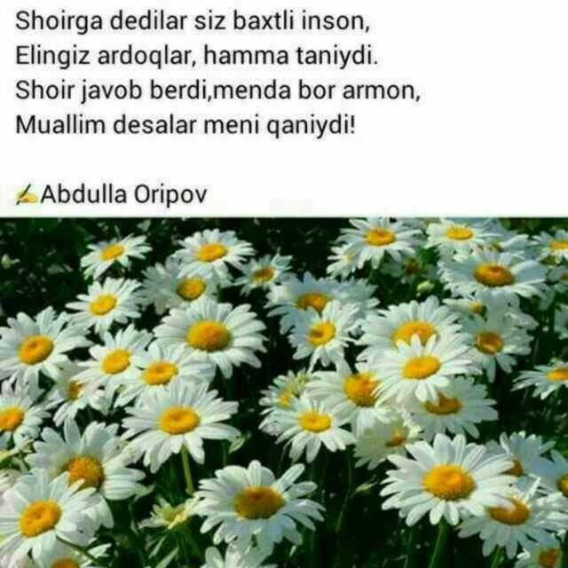
4-sinf Ona tili darsligida Sõz va sõz tarkibi mavzusi tahlili
Sõz va sõz tarkibi 125-128-mashq
Sõz va sõz tarkibi 129-131-mashq
Sõz va sõz tarkibi 132-134-mashq
Sõz va sõz tarkibi 135-mashq
Ot yasovchi qõshimchalar 251-253-mashq
Ot yasovchi qõshimchalar 254-257-mashq
Ot yasovchi qõshimchalar 258-261-mashq
Sifat yasovchi qõshimchalar 296-299-mashq
Sifat yasovchi qõshimchalar 300-304-mashq
Sifat yasovchi qõshimchalar 305-307-mashq
Sifat yasovchi qõshimchalar 308-312-mashq
Fe'l yasovchi qõshimchalar 421-424-mashq
Fe'l yasovchi qõshimchalar 425-427-mashq
Fe'l yasovchi qõshimchalar 428-430-mashq
Fe'l yasovchi qõshimchalar 431-433-mashq
Fe'l yasovchi qõshimchalar 434-435-mashq
Fe'l yasovchi qõshimchalar 436-437-mashq
👩‍💻

Slide 7


